Slide 1
VisioSpeak –Integrated Image Captioning-to-Speech Accessibility Solution

Slide 2
TABLE OF CONTENTS
01
02
03
04
05
06
PROBLEM STATEMENT
OBJECTIVE
DATA SOURCE & PREPARATION
DATA MODELLING
MODEL EVALUATION
RECOMMENDATION

Slide 3
PROBLEM STATEMENT
Visually impaired individuals encounter difficulties in comprehending visual information, leading to challenges in navigating and understanding their surroundings. This project aims to address these challenges by developing a computer vision system capable of automatically generating descriptive captions for images.
The central question is: "How can we empower visually impaired individuals through a system that interprets and communicates image content in a clear and actionable manner?"

Slide 4
OBJECTIVE
BRIDGING THE GAP
ENHANCING DAILY LIVES
The primary goal of this project is to develop an intelligent system using a combination of computer vision and natural language processing techniques. By leveraging the VGG16 model for feature extraction and a deep learning architecture for caption generation, the system aims to automatically generate captions for images. Integration with OpenAI's GPT-3.5 API enhances the system's ability to provide coherent and context-aware responses to user interactions.
The significance of this project lies in its potential to significantly improve the daily lives of visually impaired individuals. By granting them access to visual information through descriptive captions, the project contributes to the broader field of assistive technology, fostering inclusivity and independence in an increasingly visual world.

Slide 5
DATA SOURCE & PREPARATION
The project utilizes two primary data sources: images downloaded from Flickr, covering diverse scenes, and corresponding captions manually annotated by humans. Specific details about the dataset, including size and distribution, can be found in the code.
Link : Flickr32k
The data preparation process involves cleaning textual captions by removing noise and preprocessing them through techniques like lowercase conversion and tokenization. Image features are extracted using the pre-trained VGG16 model, and the data is partitioned into training and test sets. A generator function is employed to handle data in batches during model training.

Slide 6
DATA MODELLING
IMAGE CAPTIONING
GPT 3.5 ENABLED ACTIONABLE DIRECTIVES
EMPOWERING VISUALLY IMPAIRED WITH TEXT-TO-SPEECH GUIDANCE
Our project transcends traditional image captioning, empowering visually impaired individuals through advanced technology.
GPT-3.5's advanced capabilities facilitate the generation of precise directives with contextual relevance, enhancing user guidance through intricate visual scenarios.
Utilizing sophisticated algorithms, this system converts written content into auditory experiences, delivering precise guidance tailored for visually impaired users

Slide 7
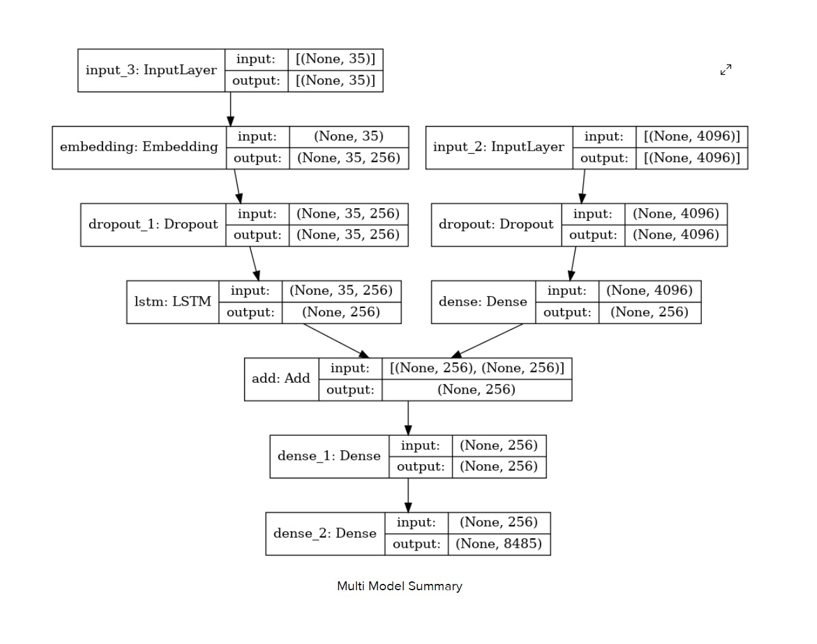
Multi Model Summary

Slide 8
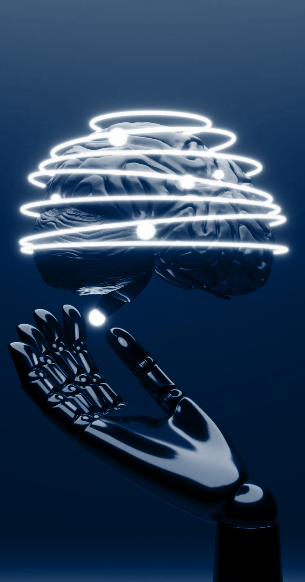
IMAGE CAPTIONING
INPUT
Images: Loaded and preprocessed using VGG16.
Captions: Extracted from a text file, preprocessed for tokenization.
OUTPUT
Image Features: VGG16-extracted features stored in a dictionary.
Tokenized Captions: Preprocessed captions ready for training.
Captioning Model: Trained model capable of generating captions for input images.
TOOLS USED
VGG16 Model: TensorFlow Keras' pre-trained model for image feature extraction.
Tokenizer: Keras Tokenizer for text preprocessing.
Embedding Layer: Part of the captioning model for textual representation.
LSTM Layer: Sequential processing in the decoder of the captioning model.
Categorical Cross entropy Loss: Used during model compilation.
Adam Optimizer: Optimizer for weight updates during model training.

Slide 9
GPT 3.5 ENABLED ACTIONABLE DIRECTIVES
INPUT
System Message: Guides GPT-3.5 on the reasoning process.
User Messages: Include image captions for contextual understanding
OUTPUT
Responses are generated providing actionable directives.
TOOLS USED
OpenAI GPT-3.5 API: Utilized for natural language understanding and response generation.
Prompt Engineering: System and user messages structured to guide GPT-3.5's responses.

Slide 10
EMPOWERING VISUALLY IMPAIRED WITH TEXT-TO-SPEECH GUIDANCE
INPUT
System Message: Guides GPT-3.5 on the reasoning process.
User Messages: Include image captions for contextual understanding
OUTPUT
Audio File: The converted audio is saved as an MP3 file in the specified working directory.
Playing the converted audio file.
TOOLS USED
gTTS: This is used for text-to-speech conversion.
os: This module is used for interacting with the operating system, in this case, for saving the converted audio file.
playsound: Used to play the converted audio file.

Slide 11
Evaluation

Slide 12
Image captioning:
Model training:
Model prediction
Inputs: Image features extracted using VGG16.
Tokenized captions preprocessed for training.
Outputs: Trained model with optimized parameters.
Metrics: Categorical cross entropy Loss, Adam Optimizer.
Results: Successful convergence of the model with minimized loss.
Inputs: Actual captions from the test set.
Outputs: Predicted captions generated by the model.
Metrics: BLEU-1 score: This suggests that, on average, over half of the unigrams in the generated text match with those in the reference text.
BLEU-2 score: This indicates that about 29% of bigrams in the generated text align with those in the reference text.
BLEU-1 score: 0.537292
BLEU-2 score: 0.288973

Slide 13
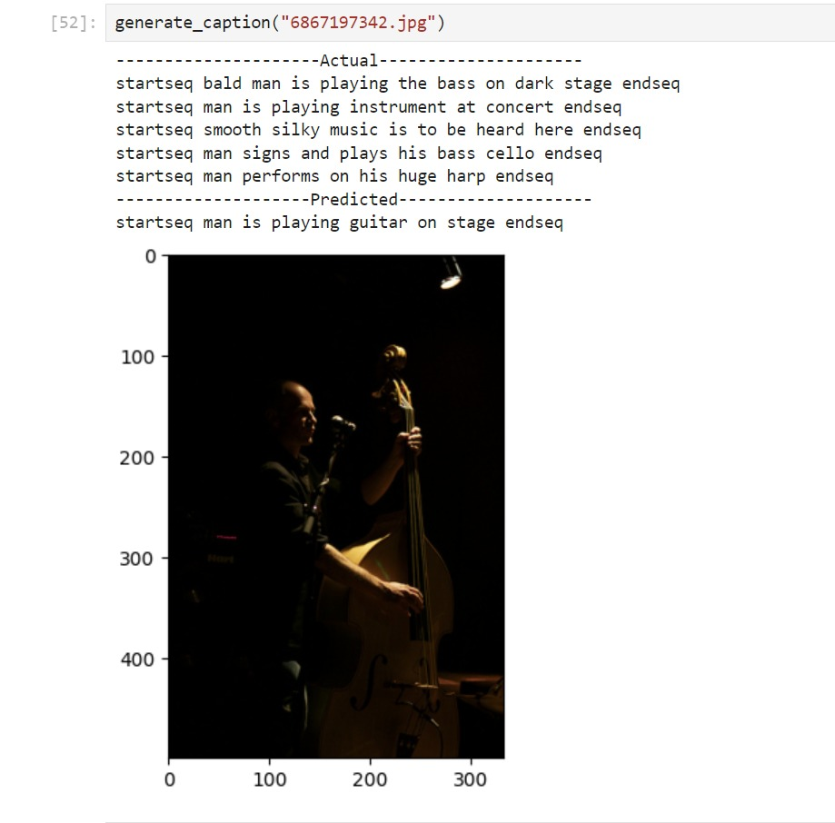

Slide 14
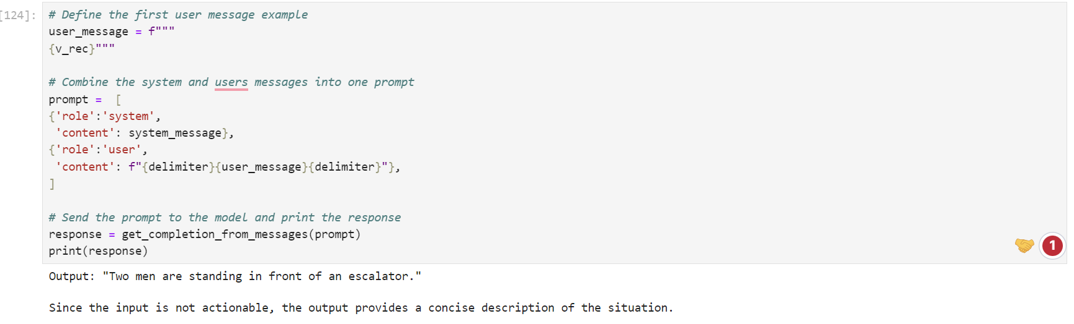
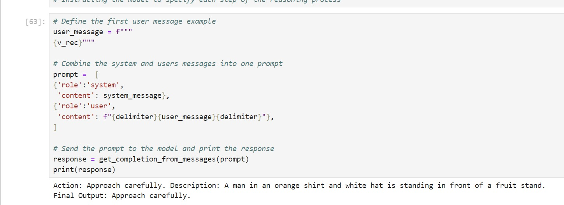
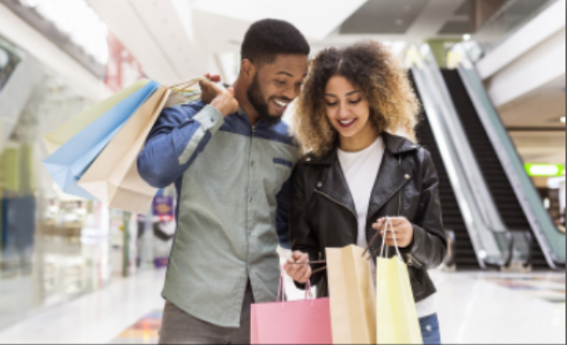
Prompt Effectiveness:
Inputs: System message instructing GPT-3.5.
User messages including image captions.
Outputs: GPT-3.5 responses providing actionable directives.
Metrics: Qualitative assessment of directive clarity.
Results: Responses demonstrate effective guidance for users.
User Interaction Quality
Inputs: Integration of GPT-3.5 responses into user interactions.
Outputs: Coherent and context-aware user interactions.
Metrics: Subjective assessment of user interaction quality.
Results: Natural and meaningful interactions enhancing user experience.

Slide 15
Empowering visually impaired with text-to-speech guidance:
For evaluating the text-to-speech output the following metric can be further implemented:
Mean Opinion Score (MOS): MOS is a subjective measure where human listeners rate the naturalness of synthesized speech on a scale. A group of listeners evaluate the quality of the speech, and their scores are averaged.

Slide 16
RECOMMENDATIONS
Fine-tune the model with diversified training datasets and explore alternative pre-trained models.
Refine the integration of GPT-3.5 through precise instructions and varied prompts.
Augment user experience with additional accessibility features, such as voice commands and real-time image recognition.
Establish a continuous feedback loop for iterative system improvement.
Collaborate with assistive technology developers for a more comprehensive solution.
Conduct user education and outreach efforts to increase awareness and adoption.

Slide 17
THANKS!
CONTRIBUTORS:
ADITYA TIWARI
GARIMA SMRITY
HIMANSHU PRAJAPATI
RIYA SINGH
SALINI MAHAPATRA

Slide 18
RESOURCES
https://jespublication.com/upload/2021-V12I1116.pdf
https://www.datacamp.com/tutorial/using-gpt-models-via-the-openai-api-in-python
https://www.geeksforgeeks.org/convert-text-speech-python/

